Slide 1








DEVOPS PLANNING
DevOps Planning and Its Tools
A connected workflow for faster releases, safer changes, and continuous operational visibility.
Pipeline
Automation
Observability

Slide 2





AGENDA
From DevOps basics to the working flow
A clean preview of the journey: lifecycle, tools, tradeoffs, and a practical example.
Introduction to DevOps
Planning the lifecycle
What DevOps changes, why it matters, and how teams think differently.
Map the DevOps lifecycle from planning through release and feedback.
Tools, benefits, challenges
Workflow and conclusion
See the platform pieces, the gains they unlock, and the friction to manage.
Close with an example pipeline that connects the full story end to end.

Slide 3
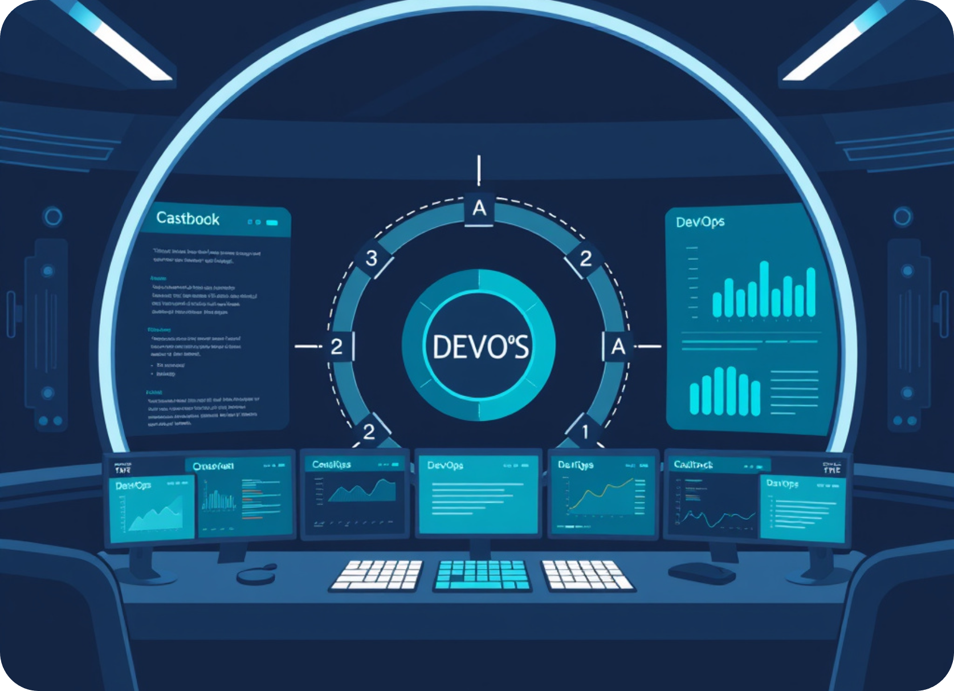




INTRODUCTION
DevOps unifies software building and running
A collaborative operating model that speeds delivery without sacrificing quality.
Development + operations
Teams align around the same software outcome.
Collaboration and automation
Shared workflows reduce manual handoffs and drift.
Continuous delivery
Smaller releases move faster, with more confidence.
DevOps is less a team structure than a disciplined way to ship reliable software continuously.

Slide 4

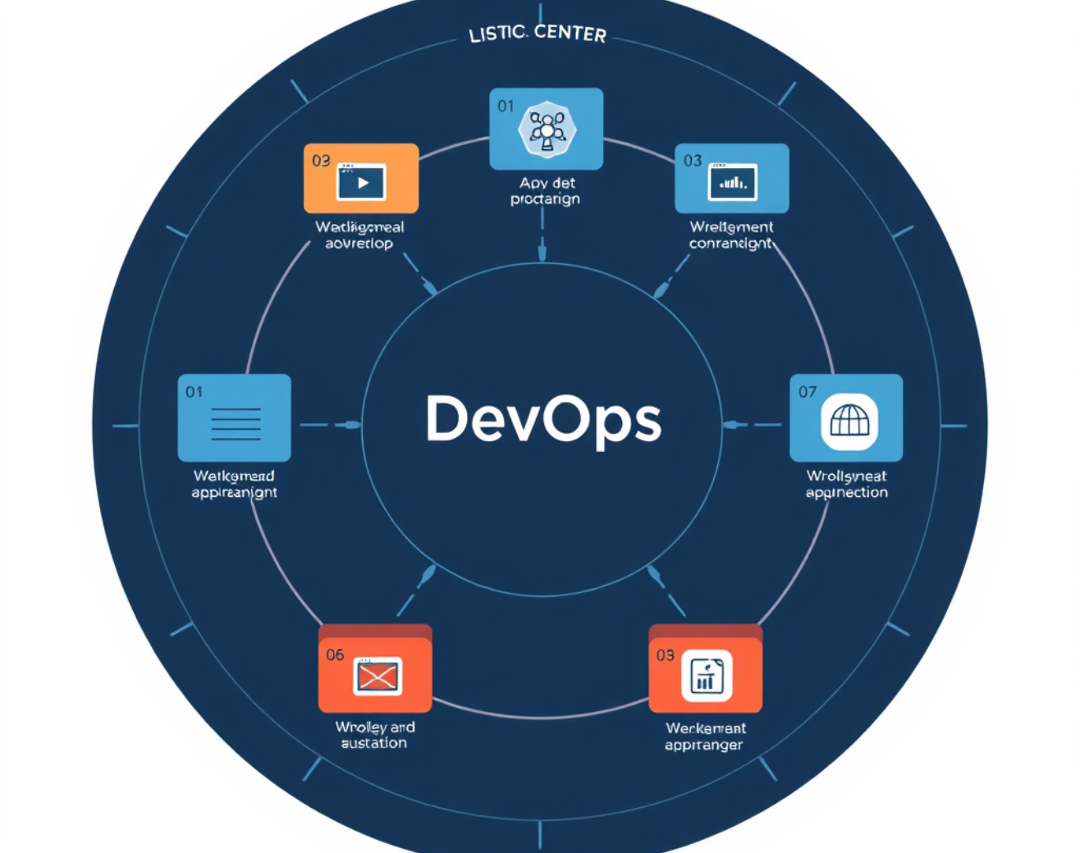




DEVOPS LIFECYCLE BASICS
What is DevOps Planning?
Planning organizes work before coding begins so the team knows what to do, who owns it, and how delivery stays smooth.
Planning turns intent into a clear path
Planning view
Before coding
It defines the tasks, priorities, and responsibilities before the build starts. That shared plan helps teams avoid delays, reduce confusion, and move through the lifecycle with less friction.
Clear ownership
Prioritized work
Fewer surprises
Good planning keeps the team aligned from idea to release.
Simple upfront planning prevents rework later.

Slide 5



DEVOPS LIFECYCLE
A continuous loop from plan to monitor
Each stage feeds the next, then feedback returns to Plan for the next iteration.
Circular workflow
Continuous improvement
LOOP LOGIC
The loop stays visible at every stage, showing how delivery and operations reinforce one another.
Feedback closes the cycle
Monitoring informs the next plan, so improvements compound instead of resetting.
WHAT THE DIAGRAM SAYS
Stages move clockwise through delivery.
The last step feeds directly back to Plan.
FLOW
OPERATE
Every pass should improve the next release.
Plan → Code → Build → Test
Release → Deploy → Operate → Monitor

Slide 6



DEVOPS PLANNING PHASE
Plan work before it becomes delivery pressure
Align stakeholders, organize the backlog, and keep releases moving with clear collaboration and fast feedback.
Requirements
Backlog Control
CORE PLANNING HUB
Release Rhythm
Gather stakeholder needs early so scope, priorities, and approvals are visible before sprint work starts.
Coordinate sprints, releases, and feedback cycles so planning stays connected to delivery and learning.
Manage tasks with boards and backlogs so the team can see what matters now, what waits, and what moves next.
Capture business goals and constraints
Keep priorities ordered in one visible board
Confirm ownership before planning begins
Surface blockers before they slow delivery
Plan sprint goals with release dates
Close the loop with feedback cycles

Slide 7





DEVOPS PLANNING TOOLS
Popular tools, each with a clear planning job
Use the right board for the right kind of work — agile tracking, work items, simple task boards, or code-linked planning.
4 TOOLS
Jira
Azure Boards
Best for agile project tracking and sprint planning.
Work item management inside the Microsoft ecosystem.
Structured issue tracking for teams that need status, ownership, and backlog visibility.
Agile
Pairs naturally with repos, pipelines, and team workflows already in Azure.
Work items
Trello
GitHub Projects
Simple visual task boards for fast classroom demos.
Code-linked planning for teams shipping from the repo.
Easy to scan when you want a lightweight board without process overhead.
Visual
Best when planning needs to stay close to issues, branches, and pull requests.
Code-linked

Slide 8








Planning tools, explained
Explanation of Each Planning Tool
Four common tools, each strong in a different planning style — from agile execution to code-connected coordination.
Agile execution
Lightweight coordination
Best for structured delivery
Best for fast-moving teams
Jira
Trello
Strong agile boards and issue tracking.
Simple drag-and-drop task management.
Azure Boards
GitHub Projects
Work items, sprints, and dashboards in one place.
Planning connected directly to code.
Verdict: Jira and Azure Boards fit disciplined planning; Trello stays easiest; GitHub Projects is strongest when planning should live beside the code.
CHOOSE BY WORKFLOW

Slide 9





DEVOPS PIPELINE MAP
Tools across every stage of delivery
From planning to monitoring, each layer uses a focused toolset that keeps the workflow moving.
Planning
Backlog
Development
Source
Jira, Trello
Git, GitHub
Shape priorities, assign work, and keep delivery visible before code begins.
Version control, collaboration, and code review stay anchored in one shared source of truth.
CI/CD
Automate
Monitoring
Observe
Jenkins, GitHub Actions
Prometheus, Grafana
Build, test, and deploy on every change so release flow stays fast and repeatable.
Track health, surface anomalies, and keep the live system visible after deployment.
One pipeline, four tool layers — each stage supports the next.
Plan → Build → Release → Observe

Slide 10
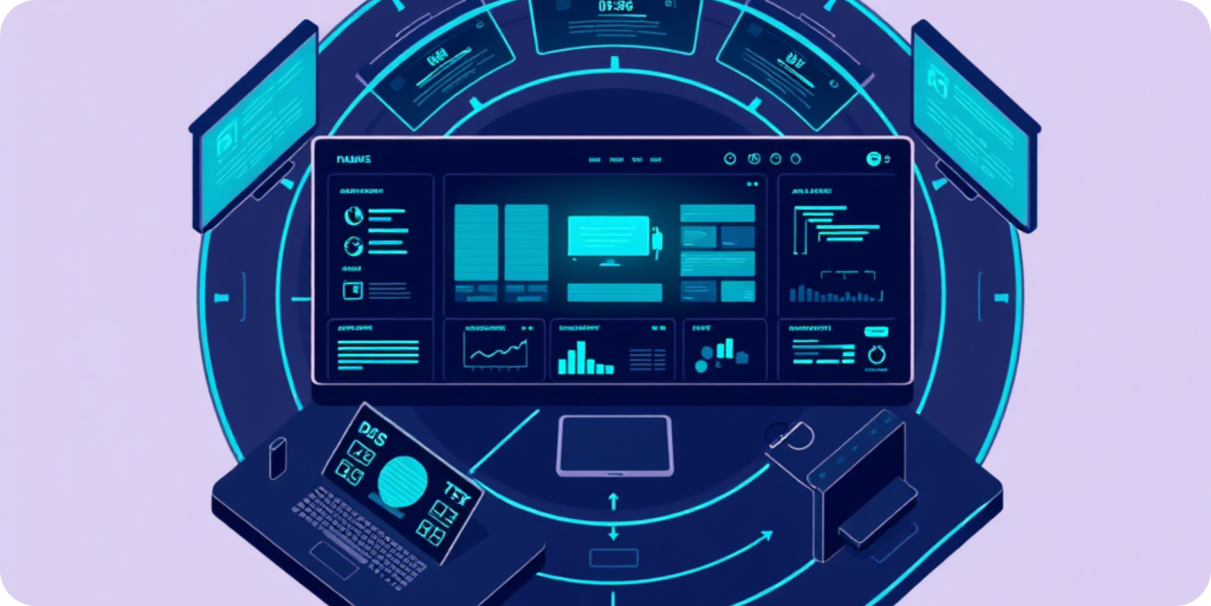







DEVOPS PLANNING BENEFITS
One plan. Faster delivery. Better control.
Planning aligns teams, removes friction, and catches issues before they slow the release.
Collaboration becomes the default
Shared planning keeps product, engineering, and operations moving as one team.
Delivery gets faster and steadier
Clear priorities and repeatable steps reduce rework and release risk.
Problems surface earlier
Planning creates visibility, so teams spot blockers before they spread.
Connected pipeline
Plan → Build → Release
Improved productivity and transparency across the release flow
Teams aligned
Flow visible
Shared priorities and fewer handoff gaps.
Work and blockers are easy to track.

Slide 11


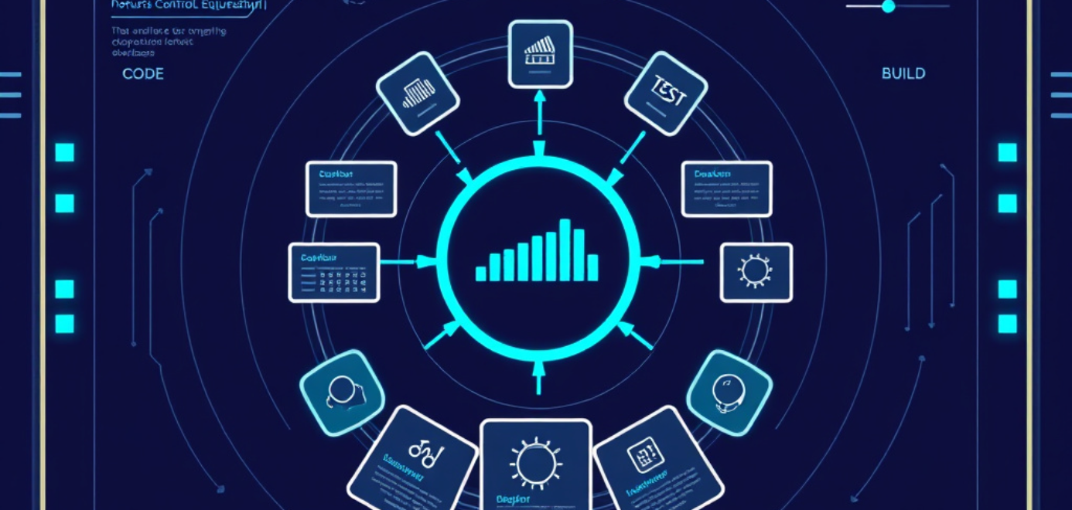





DevOps planning
Challenges in DevOps Planning
The biggest barriers are people, process, security, and skills — all of them appear before the first release.
Where planning slows down
Control-center view
Four risks that compound each other
A pipeline is only as strong as its weakest transition
Cultural resistance
Teams hesitate when delivery habits and ownership boundaries shift.
Tool complexity
Integration gaps create handoffs, rework, and fragile workflows.
Security across workflows
Change adoption
Tool integration
Security by design
Controls must travel with code, builds, deployments, and approvals.
Skills enablement
Skill shortages
The pipeline stalls when expertise is uneven across teams.

Slide 12

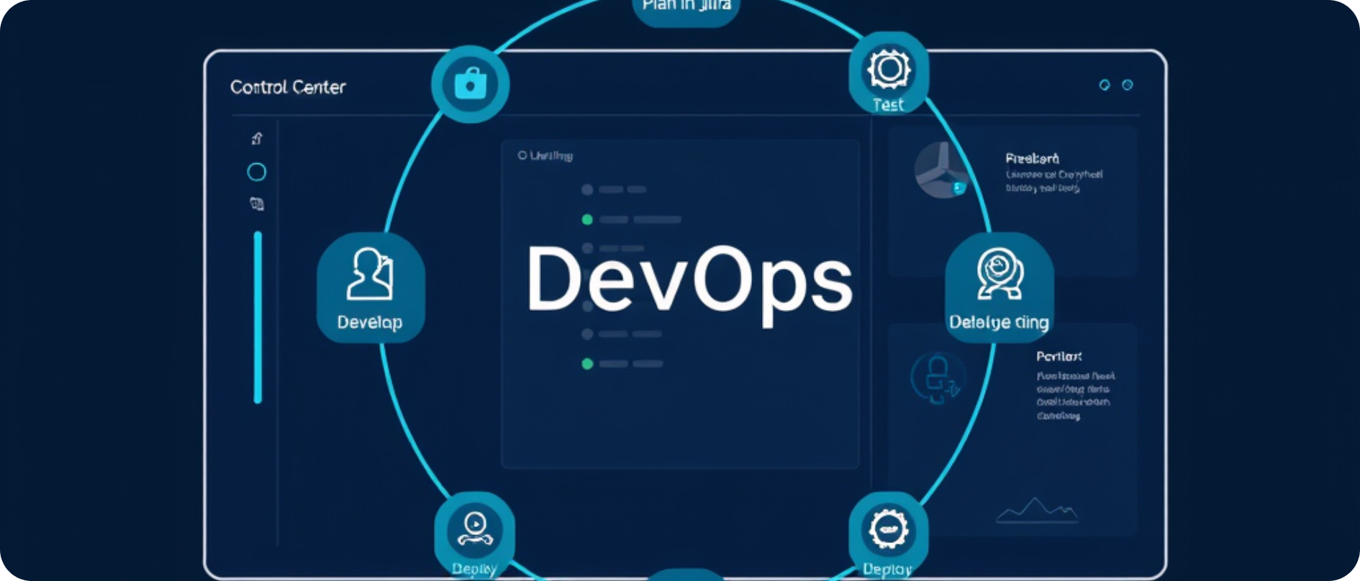



WORKFLOW AND CONCLUSION
Plan, ship, learn — then repeat with confidence
A connected DevOps loop turns tools, delivery, and feedback into one continuous operating rhythm.
CONNECTED DELIVERY LOOP
TAKEAWAY
Intelligent pipeline, one operating view
Continuous flow
Good planning and tools drive DevOps success
Plan the work in Jira or Trello
Make the backlog visible and priorities explicit.
Develop, test, and deploy as one flow
Keep handoffs clean so delivery stays fast.
A disciplined loop is the real advantage — not just the tools themselves.
Monitor performance and collect feedback
Use live signals to improve the next release.

